Slide 1

UNIT-4 requirements ENGINEERING
Er. Deeyoranjan Dongol

Slide 2
Requirement Engineering
The process of finding out, analyzing, documenting and checking the services provided by the system and its operational constraints
Classification of Requirements
User Requirement
Statement of what services the system is expected to provide and constraints under which it must operate
System Requirement
Set out the systems function, services and operational constraints in detail

Slide 3
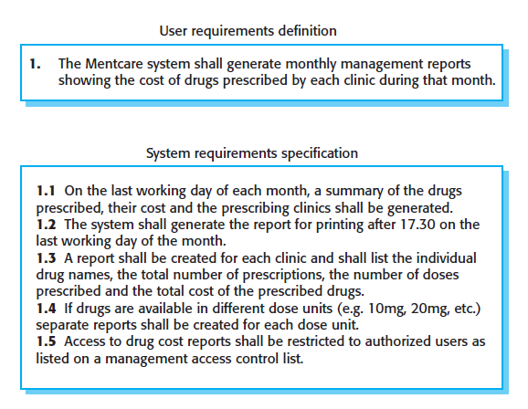

Slide 4
Classification of Software System Requirements
Functional Requirements
Non-Functional Requirements
Functional Requirements
Statements of services the system should provide, how the system should react to particular inputs and how the system behave in particular situations
Depends on type of software being developed, the expected user of the software and general approach taken by the organization when writing requirements

Slide 5
Non-Functional Requirements
Constraints on the services or functions offered by the system
May be related to emergent properties
May define constraint such as capabilities of I/O devices and data representation
Applies to the system as whole rather than individual system features or services

Slide 6
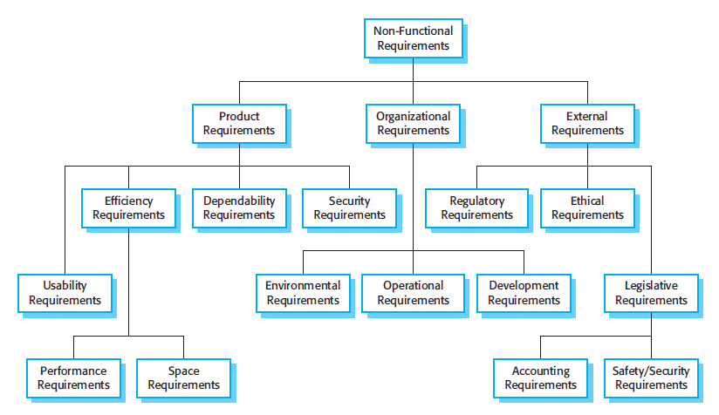
Types of Non-Functional Requirements

Slide 7
Software Requirement Specification (SRS)
Official statement of what the system developer should implement
Should include both user requirement for system and detail specification of the system requirement
Diverse set of users ranging from senior management to engineers so it has to be a compromise between
Communicating the requirements to customers
Defining the requirements in precise detail for developers and testers
Including information about possible system evolution

Slide 8
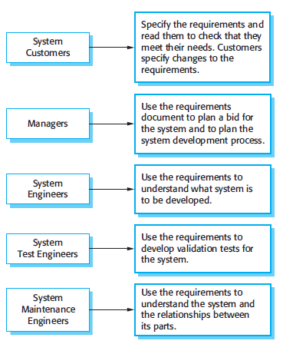

Software Requirement Specification (SRS)

Slide 9
Structure of Software Requirement Specification
PREFACE
INTRODUCTION
SYSTEM REQUIREMENTS SPECIFICATIONS
GLOSSARY
SYSTEM MODELS
USER REQUIREMENTS DEFINITION
SYSTEM EVOLUTION
SYSTEM ARCHITECTURE
APPENDICES
INDEX

Slide 10
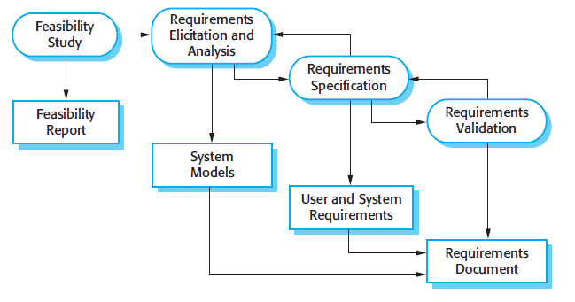

Requirement Engineering Process

Slide 11
Requirement Engineering Process
Feasibility Study
The measure of how beneficial or practical the development of information system will be to an organization
Guides the organization in determining whether to proceed with the project
Identifies the risks associated with the project that must be managed if the project is approved

Slide 12
Requirement Engineering Process
Steps in Feasibility Study
Form a project team and appoint a project leader
Prepare system flowcharts
Enumerate potential candidate systems
Describe and identify characteristics of candidate systems
Determine and evaluate performance and cost effectiveness of each candidate system
Weight system performance and cost data
Select the best candidate system
Prepare and report final project directive to management

Slide 13
Categories of Feasibility Analysis
Operational Feasibility
Technical Feasibility
Schedule Feasibility
Economic Feasibility

Slide 14
Operational Feasibility
The measure of how well the solution will work in the organization
The measure of how people feel about the system
People Oriented
Addresses two major issues:
Is the problem worth solving or will the solution to the problem work?
How do end users and management feel about the problem?
Usability Analysis
Test of system user interfaces and measured in the terms of ease of learning, ease of use and satisfaction

Slide 15
Technical Feasibility
The measure of practically of a specific technical solution and availability of technical resources and expertise
Computer Oriented
Addresses three major issues:
Is the proposed technology or solution practical?
Do we currently posses the necessary technology?
Do we possess the necessary technical expertise and is the schedule reasonable?

Slide 16
Schedule Feasibility
The measure of how reasonable is the project time-table
Determination of whether the time allocated for a project seems accurate
Economic Feasibility
The measure of cost-effectiveness of a project
Identifying cost and benefits associated with the system, assigning values to them and calculating future cash flows and measuring the financial worthiness of the project

Slide 17
Requirement Engineering Process
Requirement Elicitation & Analysis
Software engineers work with customers and system end-users to find out about
The application domain
What services the system should provide
The required performance of the system
Hardware and software constraints

Slide 18
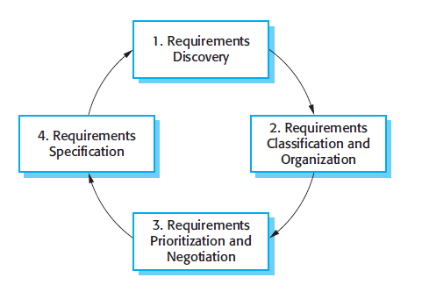
Requirement Engineering Process
Requirement Elicitation & Analysis Process Model

Slide 19
Requirement Engineering Process
Requirement Specification
Process of writing down the user and system requirements in a requirements document
Should be precise, unambiguous and complete
Should specify merits and demerits along with recommendation of requirement
Ways of Writing Requirement Specification
Natural language sentences
Structured natural language
Design description languages
Graphical notations
Mathematical specifications

Slide 20
Requirement Engineering Process
Requirement Validation
Process of checking that requirements actually define the system that the customer really wants
Different checks carried out during validation
Validity checks
Consistency checks
Completeness checks
Realism checks
Verifiability
Requirement Validation Techniques
Requirement review
Prototyping
Test case generation

Slide 21
Requirements Change
Requirements Management Planning
Concerned with establishing how a set of evolving requirements will be managed
During the planning stage, following issues must be addressed
Requirement identification
A change management process
Traceability policies
Tool support

Slide 22
Requirements Change
Requirements Management Planning
During the planning phase tool support is needed for
Requirement storage
Change management
Traceability management

Slide 23
Requirements Change Management
Three principal stages to a change management process
Problem Analysis and Change Specification
During this stage, the problem or the change proposal is analyzed to check that it is valid
This analysis is fed back to the change requestor who may respond with a more specific requirements change proposal, or decide to withdraw the request
Change Analysis and Costing
The effect of the proposed change is assessed using traceability information and general knowledge of the system requirements
The cost of making the change is estimated
Once this analysis is completed, a decision is made as to whether or not to proceed with the requirements change

Slide 24
Requirements Change Management
Change Implementation
The requirements document and, where necessary, the system design and implementation, are modified
Changeability in documents is achieved by minimizing external references and making the document sections as modular as possible

